Slide 1
Walmart Sales Dashboard
Explore data-driven insights focused on optimizing Walmart sales performance.
Presented by Taruni Yadav Chirraboina on April 25, 2025.

Slide 2
Objective
Real-time Visibility
Track Walmart sales performance day-to-day.
Sales Drivers
Identify factors impacting growth and decline.
Data-Driven Decisions
Empower departments with actionable insights.
Profitability Focus
Improve store results and bottom-line outcomes.

Slide 3
Dataset Overview
Time & Location
Store ID: Unique identifier
Date: Daily sales records
Sales & Categories
Product Category: Department level
Store Type: Classification
Weekly Sales: Revenue data
External Factors
Holiday Flag: Major event indicator
Temperature & Fuel Price
CPI & Unemployment Rate

Slide 4
Key Performance Indicators (KPIs)
Total Sales
Overall revenue generated across stores.
Avg Sales per Store
Benchmark for individual store performance.
Sales by Store Type
Identify leading and lagging store categories.
Holiday Sales Impact
Measure success of promotional periods.

Slide 5
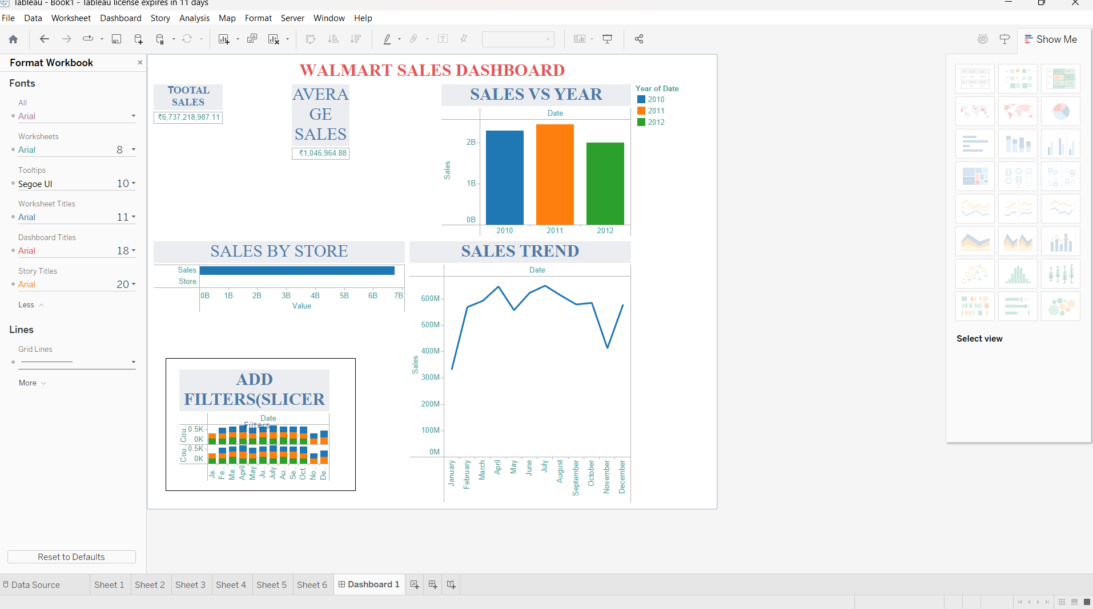
Dashboard Screenshot
Trend lines highlight sales patterns clearly.

Slide 6
Key Insights
Dominant Stores
Top stores contribute over 60% of sales.
Holiday Sales Boost
Sales spike up to 30% during key holidays.
Fuel Price Correlation
Higher fuel costs reduce sales (-0.65 correlation).
Unemployment Impact
Sales fall in Type C stores with higher unemployment.

Slide 7
Recommendations
Market Underperforming Stores
Boost visibility and local promotions.
Inventory Optimization
Adjust stock based on product sales trends.
Fuel Price Analysis
Adapt pricing considering fuel cost effects.
Targeted Holiday Promotions
Maximize sales during peak times.
Fuel Incentives
Offer promotions when fuel prices rise.

